Slide 1
Using Scattertext and the Python NLP Ecosystem for Text Visualization
Jason S. Kessler | Big Data Bellevue Meetup, November 15, 2017
@jasonkessler

Slide 2
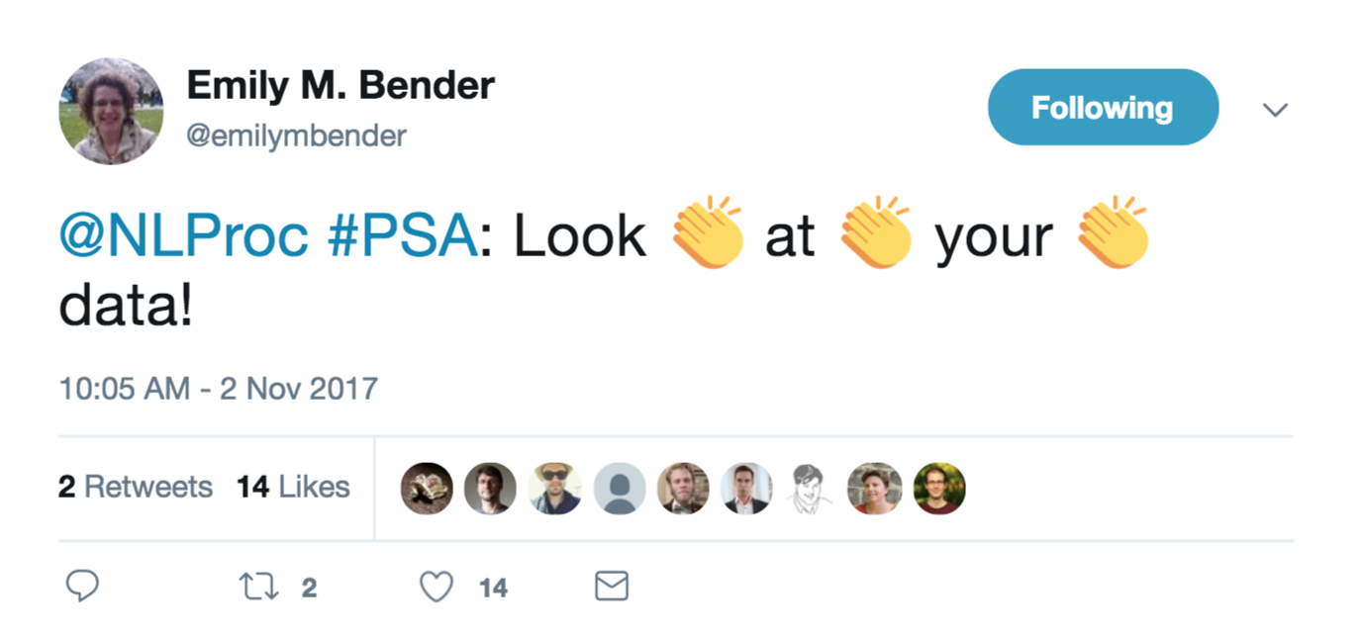
@jasonkessler
Notes:
This slide intentionally left blank. (If you do not have a page title or subtitle, leave the field as is and it will remain hidden.)

Slide 3
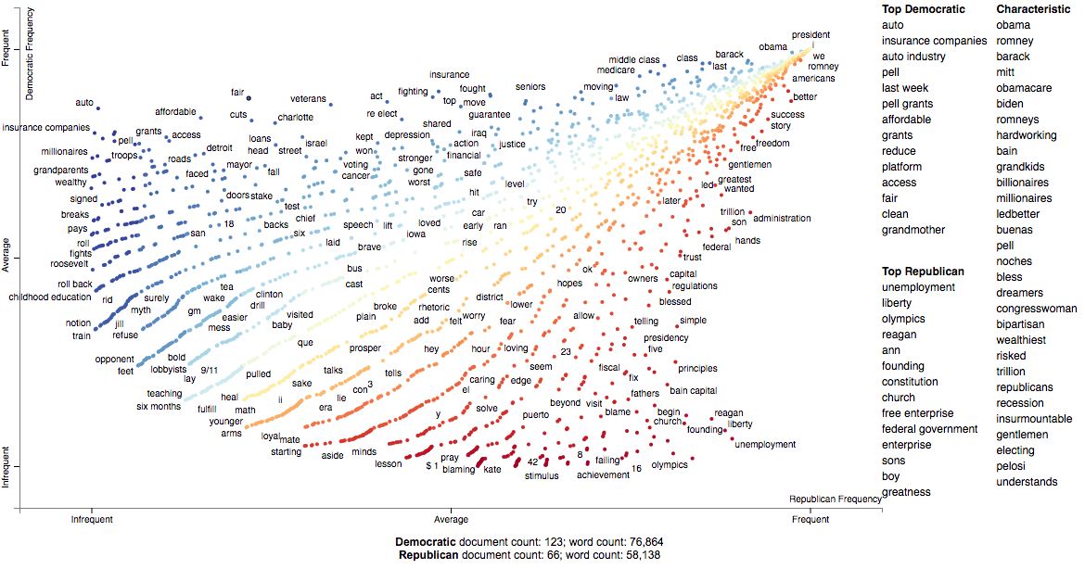
Scattertext: Democrats vs Republicans: 2012 Convention Speeches
@jasonkessler
Notes:
This slide intentionally left blank. (If you do not have a page title or subtitle, leave the field as is and it will remain hidden.)

Slide 4
Scattertext
http://bit.ly/pydatascattertext
$pip3 install scattertext agefromname
Visualize how different groups speak differently
In general
In topic-specific ways
Intersections of group types (e.g., gender and political party)
First 10 minutes will be consist of some fun case studies
Rest will consist of code examples
Includes examples of Python NLP ecosystem
spaCy, Gensim, Empath, AgeFromName
Bottom line: toolkit for computational social science
@jasonkessler

Slide 5
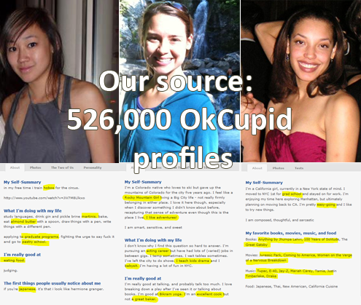

OKCupid: an online dating site
http://bit.ly/pydatascattertext
Which words and phrases statistically distinguish ethnic groups and genders?
hobos
almond
butter
100 Years of
Solitude
Bikram yoga
Christian Rudder: http://blog.okcupid.com/index.php/page/7/
@jasonkessler
Notes:
This slide intentionally left blank. (If you do not have a page title or subtitle, leave the field as is and it will remain hidden.)

Slide 6

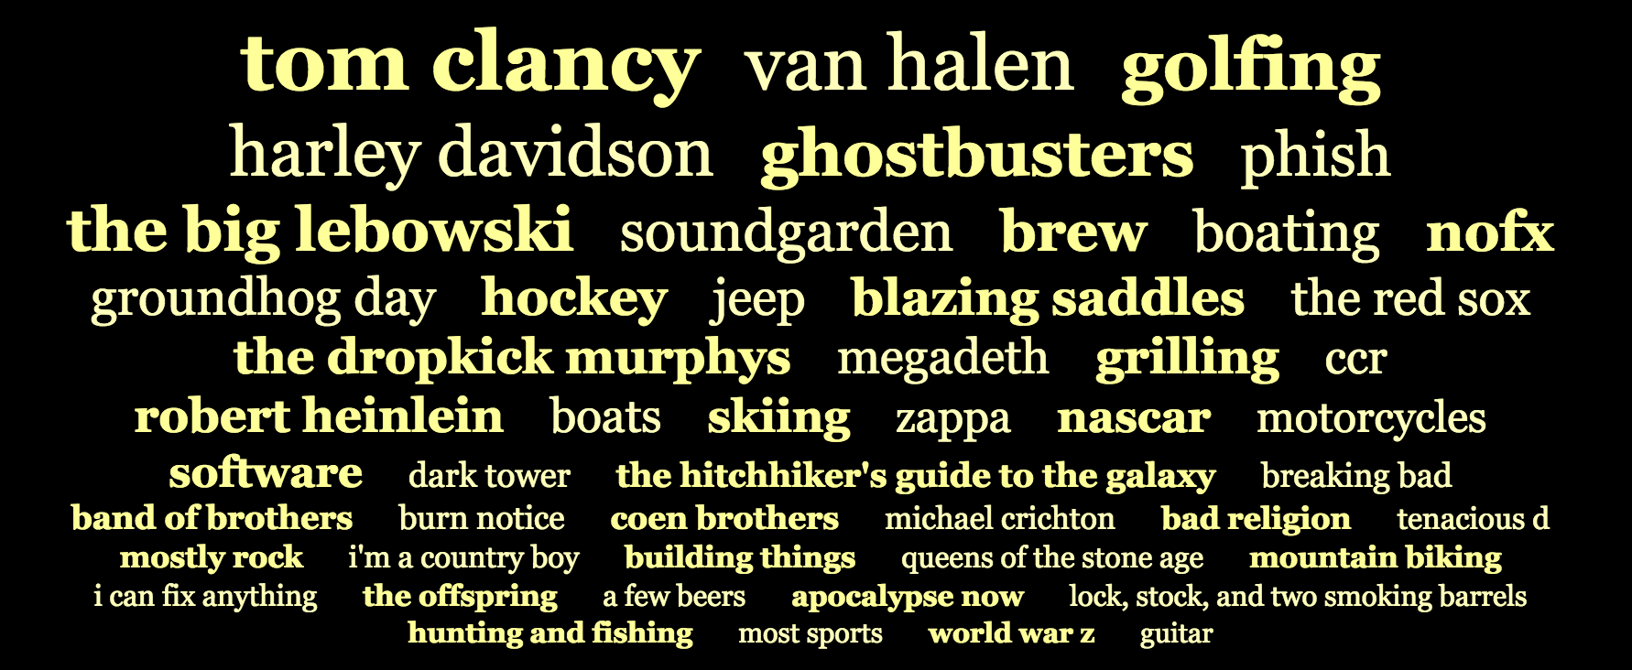
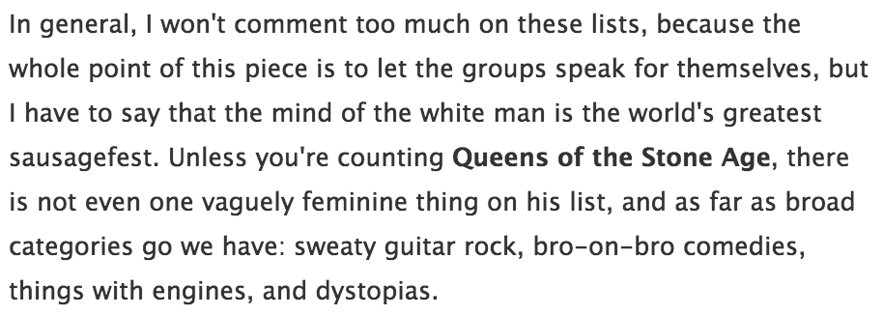
OKCupid: Words and phrases that distinguish white men.
http://bit.ly/pydatascattertext
@jasonkessler
Source: Christian Rudder. 2010. https://theblog.okcupid.com/the-real-stuff-white-people-like-66b131aa3ac8

Slide 7
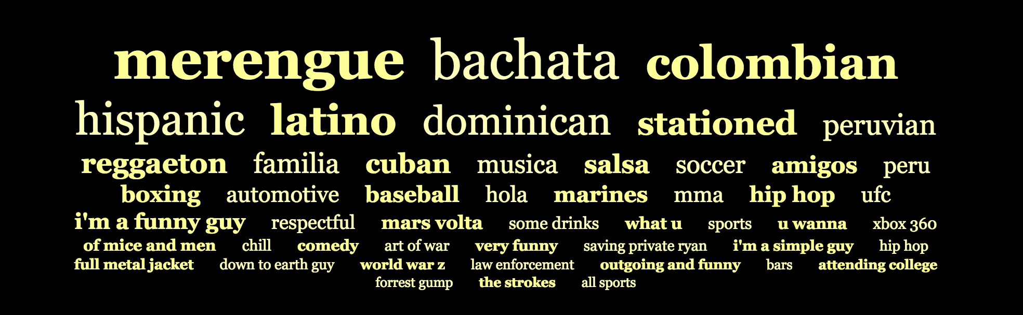
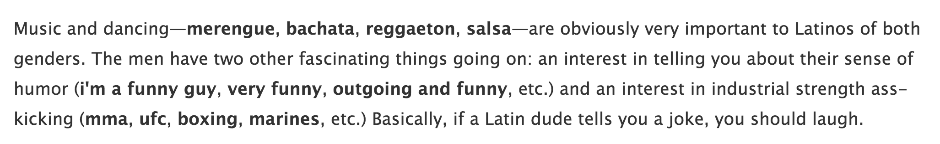
OKCupid: Words and phrases that distinguish Latin men.
http://bit.ly/pydatascattertext
Explanation
@jasonkessler
Source: Christian Rudder. 2010. https://theblog.okcupid.com/the-real-stuff-white-people-like-66b131aa3ac8

Slide 8
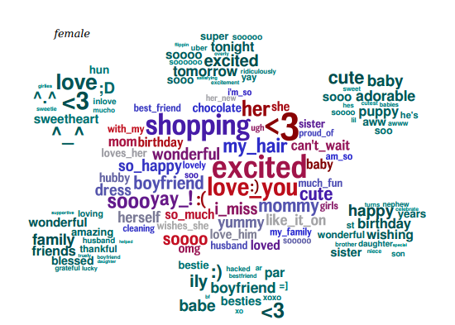
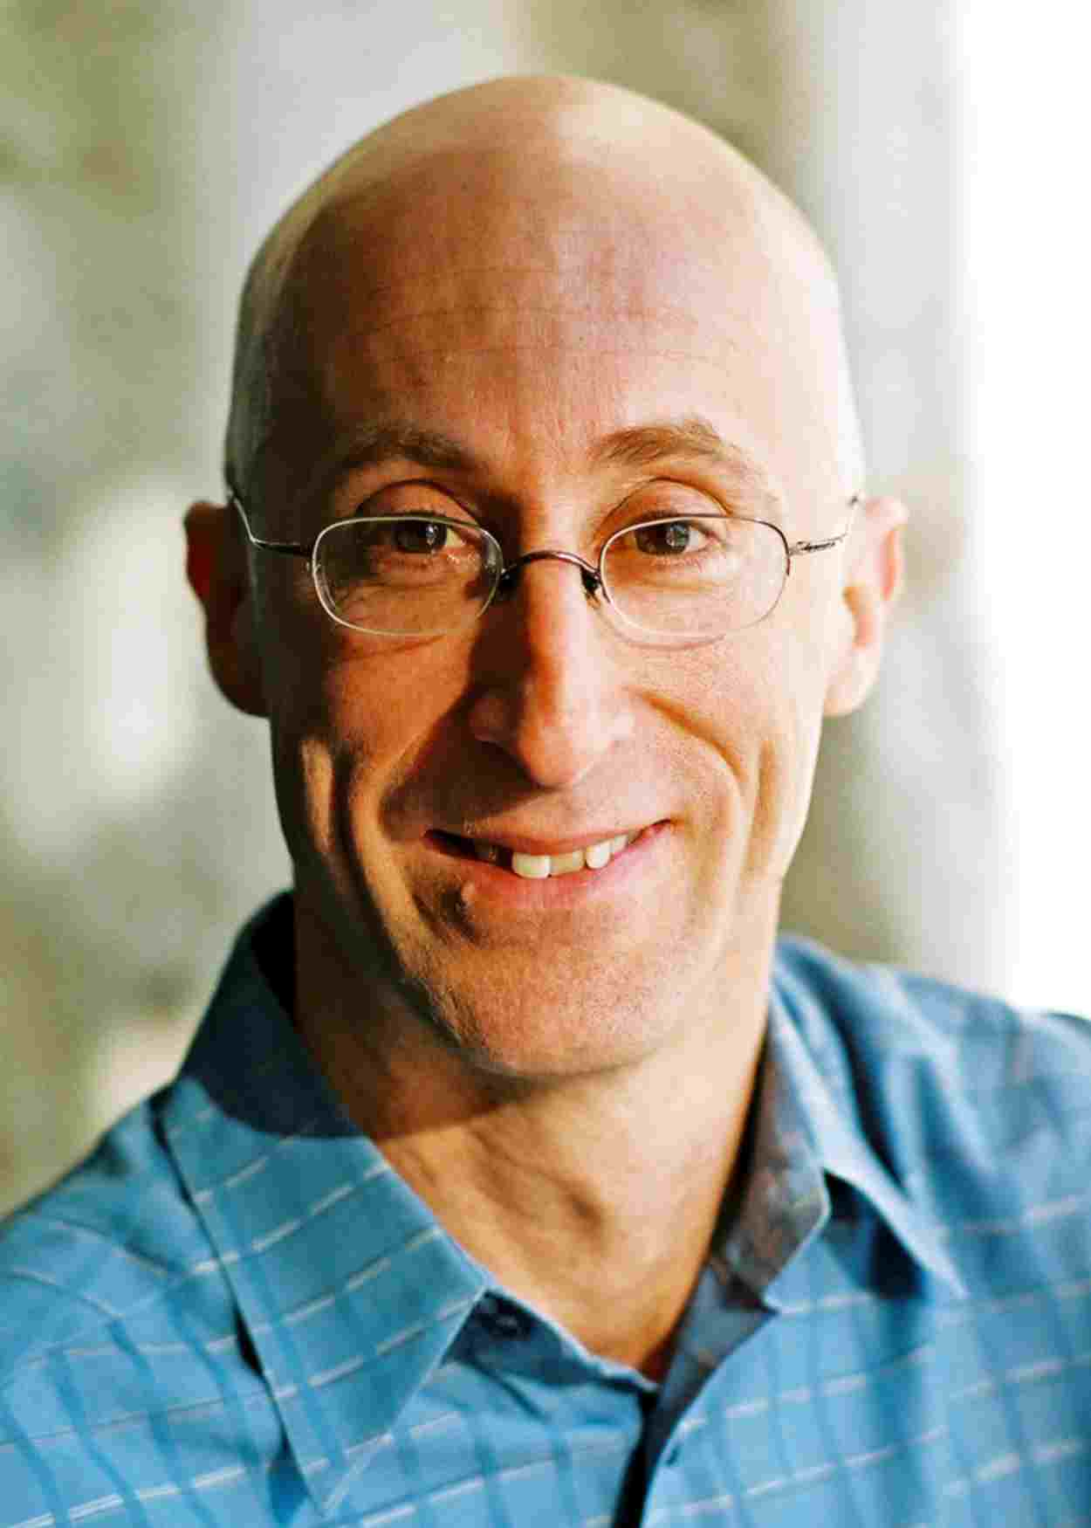
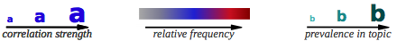
Word Use and Gender in Facebook Statuses
http://bit.ly/pydatascattertext
The good:
Word clouds force you to hunt for the most impactful terms
You end up examining the long tail in the process
Compactly represent a lot of phrases and topics
Lyle Ungar
2013 AAAI
Tutorial
@jasonkessler

Slide 9
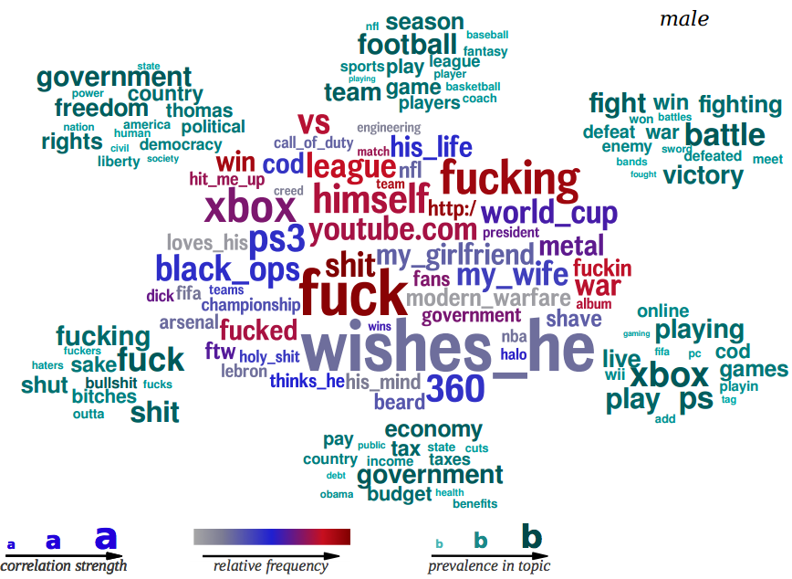
Word Use and Gender in Facebook Statuses
http://bit.ly/pydatascattertext
The bad:
“Mullets of the Internet” --Jeffrey Zeldman, 2005
Longer phrases are are more prominent.
Ranking is unclear
Does size indicate higher frequency?
Lyle Ungar
2013 AAAI
Tutorial
@jasonkessler

Slide 10
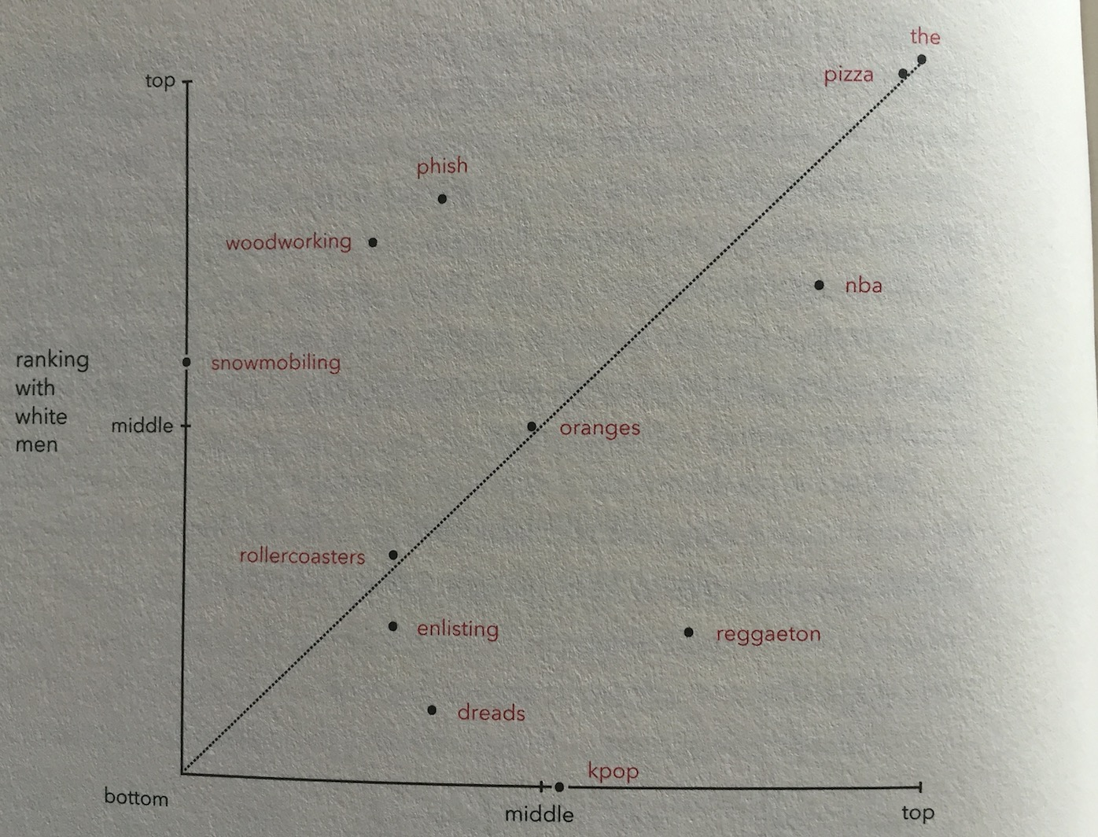
Low distance: white men
disproportionately mention Phish
http://bit.ly/pydatascattertext
The smaller the distance from the top left, the higher the association with white men.
High distance: white men
ignore k-pop
Ranking with everyone else
Source: Christian Rudder. Dataclysm. 2014.
@jasonkessler
Notes:
This slide intentionally left blank. (If you do not have a page title or subtitle, leave the field as is and it will remain hidden.)

Slide 11
http://bit.ly/pydatascattertext
my blue eyes
Source: Christian Rudder. Dataclysm. 2014.
@jasonkessler
Notes:
This slide intentionally left blank. (If you do not have a page title or subtitle, leave the field as is and it will remain hidden.)

Slide 12
http://bit.ly/pydatascattertext
DEMO
http://bit.ly/Pydata-Scattertext-1
HTML Link
Notes:
This slide intentionally left blank. (If you do not have a page title or subtitle, leave the field as is and it will remain hidden.)

Slide 13
http://bit.ly/pydatascattertext
https://fivethirtyeight.com/features/how-to-tell-someones-age-when-all-you-know-is-her-name/
@jasonkessler
Notes:
Selected terms

Slide 14
Review Language by Gender and Generation
http://bit.ly/pydatascattertext
@jasonkessler
https://fivethirtyeight.com/features/how-to-tell-someones-age-when-all-you-know-is-her-name/
Notes:
Selected terms

Slide 15
Review Language by Gender and Generation
http://bit.ly/pydatascattertext
Jan. 1999: …Baby One More Time single released
2002: breaks up with Justin Timberlake
2007: losses custody of child
2010: stars in highest rated episode of Glee
https://fivethirtyeight.com/features/how-to-tell-someones-age-when-all-you-know-is-her-name/
@jasonkessler
Notes:
Selected terms

Slide 16
http://bit.ly/pydatascattertext
TWO MORE DEMOS
HTML Link
HTML Link
http://bit.ly/Pydata-Scattertext-2
http://bit.ly/Pydata-Scattertext-3
Notes:
This slide intentionally left blank. (If you do not have a page title or subtitle, leave the field as is and it will remain hidden.)

Slide 17
http://bit.ly/pydatascattertext
Thanks you!
Any questions?
To cite Scattertext, please use
Jason S. Kessler. Scattertext: a Browser-Based Tool for Visualizing how Corpora Differ. Proceedings of the 54th Annual Meeting of the Association for Computational Linguistics (ACL): System Demonstrations. 2017.
@jasonkessler
Notes:
This slide intentionally left blank. (If you do not have a page title or subtitle, leave the field as is and it will remain hidden.)

Slide 18
Word Use Reflecting Gender and Personality in Facebook Statuses
http://bit.ly/pydatascattertext
Objective:
Find words, phrases, and topics that correlate to
gender, and
Big 5 personality type
Data source:
My Personality App
75k voluntary participants in Facebook based survey, >300mm words
Agreed to give researchers access to statuses.
Scoring algorithm
Linear regression weights, 2000 LDA topics.
Lyle Ungar
2013 AAAI
Tutorial
Schwartz et al. Personality, Gender, and Age in the Language of Social Media: The Open-Vocabulary Approach. Plos One. 2013.
@jasonkessler
Notes:
This slide intentionally left blank. (If you do not have a page title or subtitle, leave the field as is and it will remain hidden.)

